Slide 1
Introduction to Deep Learning (1)
CS771: Introduction to Machine Learning
Piyush Rai

Slide 2

Limitation of Linear Models
2
Linear models: Output produced by taking a linear combination of input features
This basic architecture is classically also known as the “Perceptron” (not to be confused with the Perceptron “algorithm”, which learns a linear classification model)
This can’t however learn nonlinear functions or nonlinear decision boundaries
Linear regression, logistic regression, SVM, etc
Some monotonic function
(e.g., sigmoid)
Although can kernelize to make them nonlinear

Slide 3
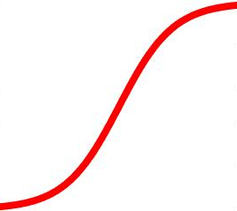
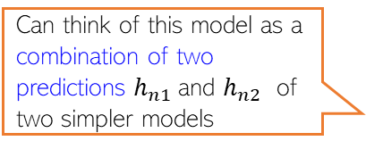
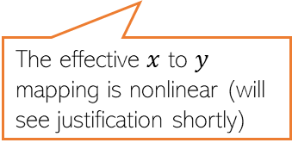
Neural Networks: Multi-layer Perceptron (MLP)
3
An MLP consists of an input layer, an output layer, and one or more hidden layers
Output Layer
(with a scalar-valued output)
Hidden layer units/nodes act as new features
Learnable weights
Hidden Layer
(with K=2 hidden units)
Can think of this model as a combination of two predictions $h_{n1}$and $h_{n2}$ of two simpler models
Input Layer
(with D=3 visible units)
The effective $x$ to $y$ mapping is nonlinear (will see justification shortly)

Slide 4
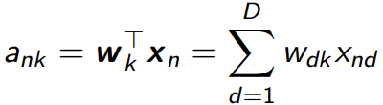

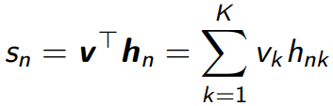
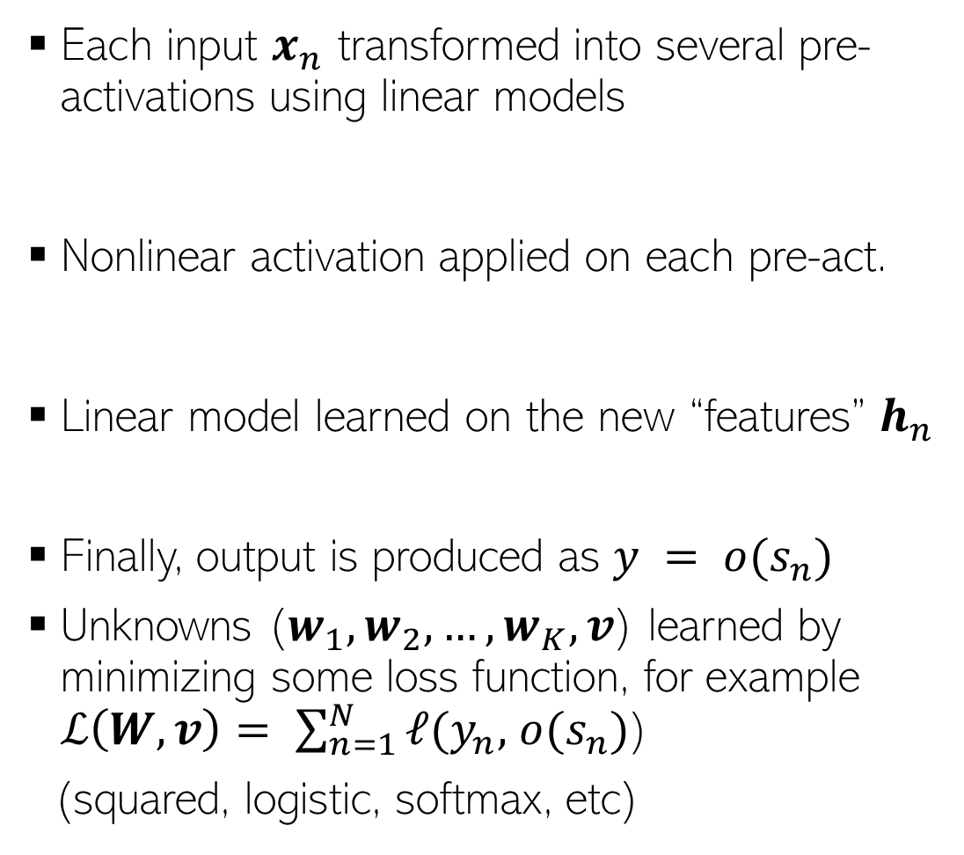
Illustration: Neural Net with One Hidden Layer
4
Each input $x_{n}$ transformed into several pre-activations using linear models
Nonlinear activation applied on each pre-act.
Linear model learned on the new “features” $h_{n}$
Finally, output is produced as $y = o(s_{n})$
Unknowns ($w_{1}, w_{2}, …, w_{K}, v$) learned by minimizing some loss function, for example $ℒ\left(W,v\right)= \sum_{n=1}^{N}{ℓ(y_{n},}$ $o(s_{n})$)
(squared, logistic, softmax, etc)
Can even be identity
(e.g., for regression y_{n} = s_{n} )

Slide 5
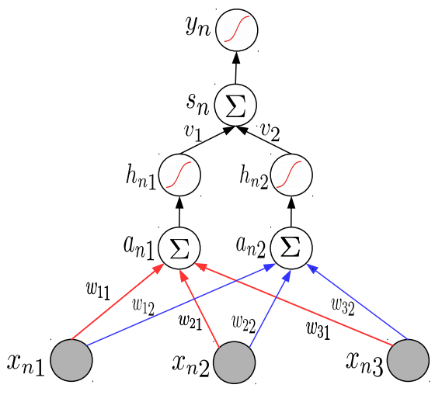
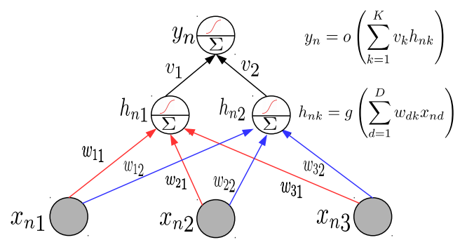

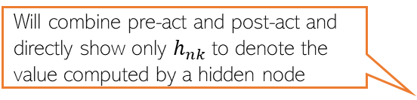
Neural Nets: A Compact Illustration
Will denote a linear combination of inputs followed by a nonlinear operation on the result
5
Note: Hidden layer pre-act $a_{nk}$ and post-act $h_{nk}$ will be shown together for brevity
Different layers may use different non-linear activations. Output layer may have none.
Will directly show the final output
Will combine pre-act and post-act and directly show only $h_{nk}$to denote the value computed by a hidden node
Single
Hidden
Layer
More succinctly..

Slide 6
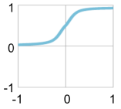
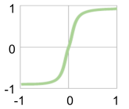

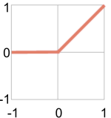
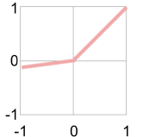

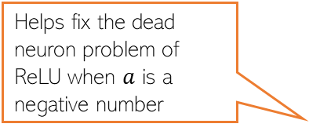
Activation Functions: Some Common Choices
6
sigmoid
tanh
For sigmoid as well as tanh, gradients saturate (become close to zero as the function tends to its extreme values)
Preferred more than sigmoid. Helps keep the mean of the next layer’s inputs close to zero (with sigmoid, it is close to 0.5)
h
h
a
a
ReLU
Leaky ReLU
ReLU and Leaky ReLU are among the most popular ones
Helps fix the dead neuron problem of ReLU when $a$ is a negative number
h
Without nonlinear activation, a deep neural network is equivalent to a linear model no matter how many layers we use
a

Slide 7
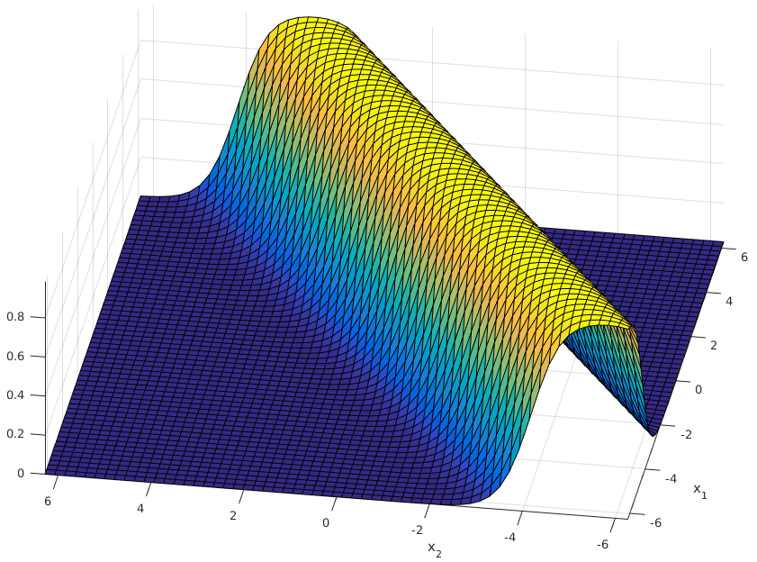
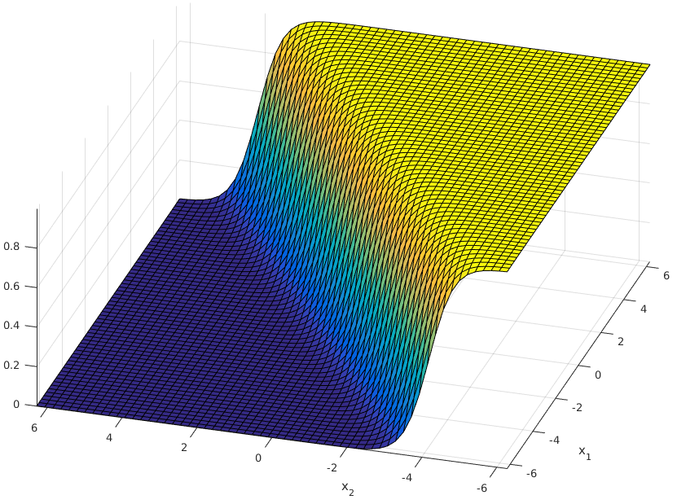
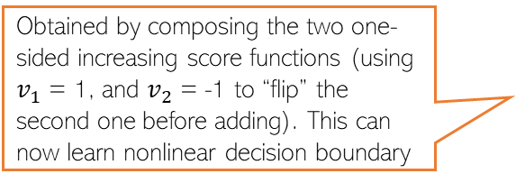
MLP Can Learn Nonlin. Fn: A Brief Justification
7
An MLP can be seen as a composition of multiple linear models combined nonlinearly
Obtained by composing the two one-sided increasing score functions (using $v_{1}$ = 1, and $v_{2}$ = -1 to “flip” the second one before adding). This can now learn nonlinear decision boundary
High-score in the middle and low-score on either of the two sides of it. Exactly what we want for the given classification problem
score
Score monotonically increases. One-sided increase (not ideal for learning nonlinear decision boundaries)
score
score
score
A nonlinear classification problem
Standard Single “Perceptron” Classifier (no hidden units)
A single hidden layer MLP with sufficiently large number of hidden units can approximate any function (Hornik, 1991)
A Multi-layer Perceptron Classifier
(one hidden layer with 2 units)
Capable of learning nonlinear boundaries

Slide 8
Examples of some basic NN/MLP architectures
8

Slide 9

Single Hidden Layer and Single Outputs
9
One hidden layer with $K$ nodes and a single output (e.g., scalar-valued regression or binary classification)

Slide 10

Single Hidden Layer and Multiple Outputs
10
One hidden layer with $K$ nodes and a vector of $C$ output (e.g., vector-valued regression or multi-class classification or multi-label classification)

Slide 11
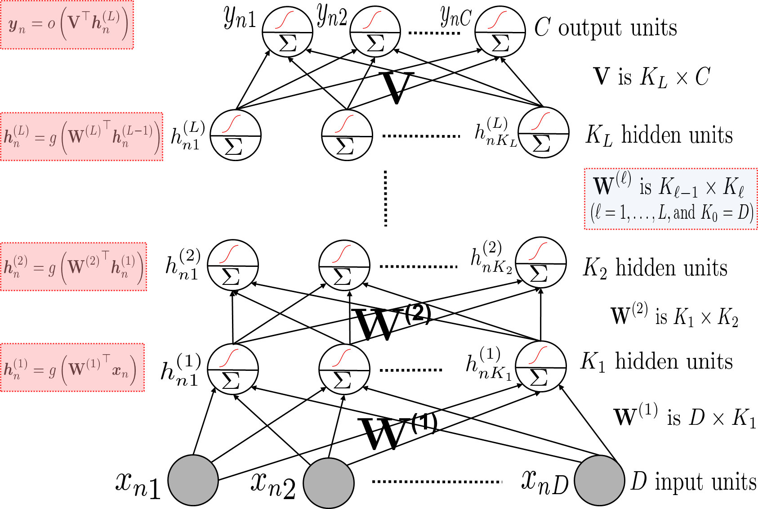
Multiple Hidden Layers (One/Multiple Outputs)
11
Most general case: Multiple hidden layers with (with same or different number of hidden nodes in each) and a scalar or vector-valued output

Slide 12
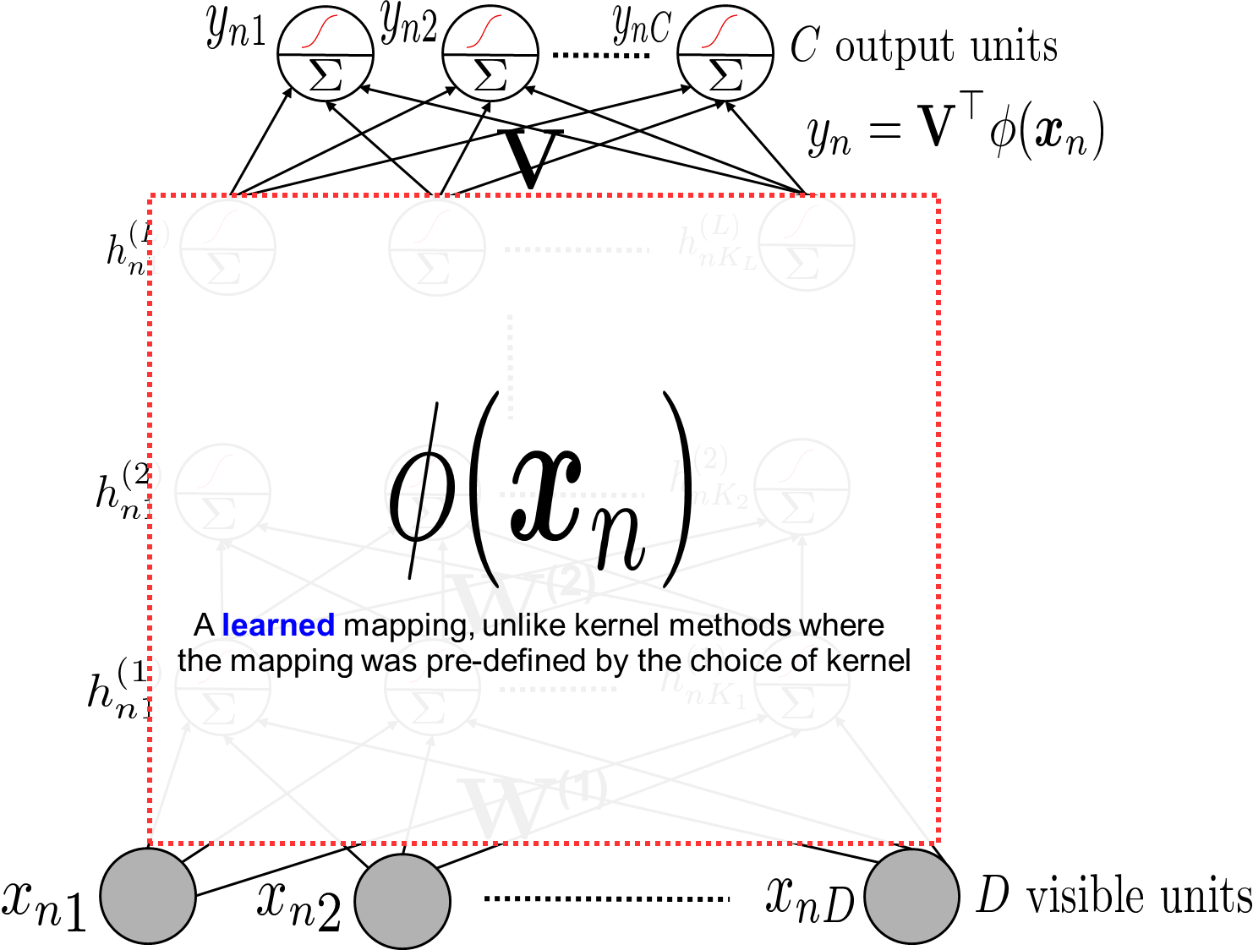

Neural Nets are Feature Learners
12
Hidden layers can be seen as learning a feature rep. $φ\left(x_{n}\right)$ for each input $x_{n}$
The last hidden layer’s values

Slide 13
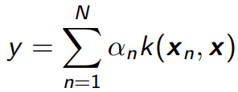
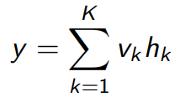
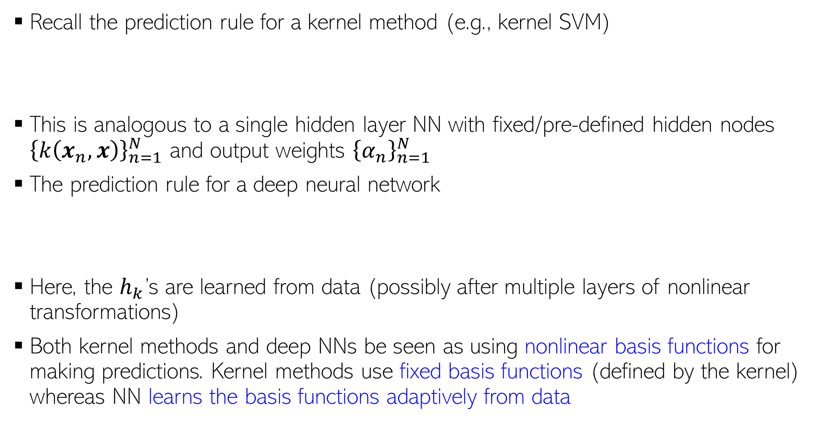
Kernel Methods vs Neural Nets
13
Recall the prediction rule for a kernel method (e.g., kernel SVM)
This is analogous to a single hidden layer NN with fixed/pre-defined hidden nodes ${\left\{k\left(x_{n}, x\right)\right\}}_{n=1}^{N}$ and output weights ${\left\{α_{n}\right\}}_{n=1}^{N}$
The prediction rule for a deep neural network
Here, the $h_{k}$’s are learned from data (possibly after multiple layers of nonlinear transformations)
Both kernel methods and deep NNs be seen as using nonlinear basis functions for making predictions. Kernel methods use fixed basis functions (defined by the kernel) whereas NN learns the basis functions adaptively from data
Also note that neural nets are faster than kernel methods at test time since kernel methods need to store the training examples at test time whereas neural nets do not

Slide 14
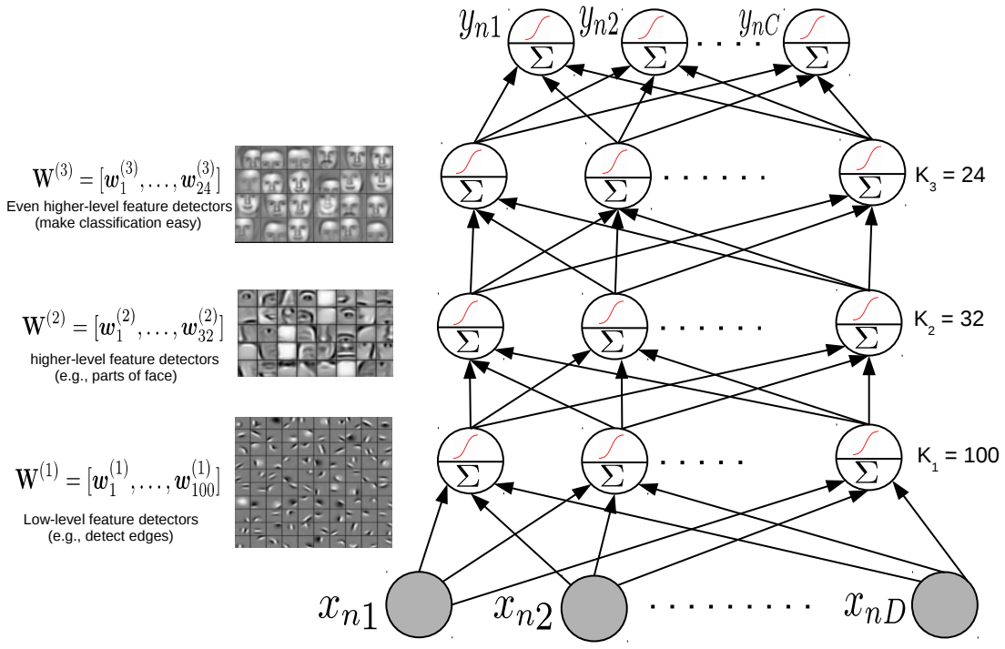


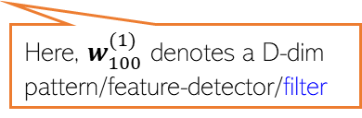
Feature Learned by a Neural Network
14
Node values in each hidden layer tell us how much a “learned” feature is active in $x_{n}$
Hidden layer weights are like pattern/feature-detector/filter
All the incoming weights (a vector) on this hidden node can be seen as representing a pattern/feature-detector/filter
Here, $w_{32}^{(2)}$ denotes a $K_{1}$-dim template/pattern/feature-detector
All the incoming weights (a vector) on this hidden node can be seen as representing a template/pattern/feature-detector
Here, $w_{100}^{(1)}$ denotes a D-dim pattern/feature-detector/filter

Slide 15

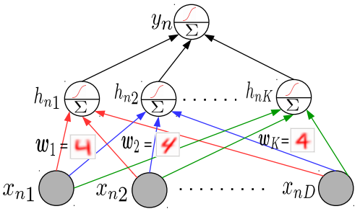
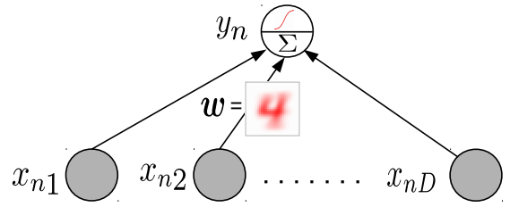
Why Neural Networks Work Better: Another View
15
Linear models tend to only learn the “average” pattern
Deep models can learn multiple patterns (each hidden node can learn one pattern)
Thus deep models can learn to capture more subtle variations that a simpler linear model

Slide 16

Backpropagation
16
Backpropagation = Gradient descent using chain rule of derivatives
Chain rule of derivatives: Example, if $y=f_{1}\left(x\right)$ and $x=f_{2}\left(z\right)$ then $\frac{∂y}{∂z}=\frac{∂y}{∂x}$ $\frac{∂x}{∂z}$
Start taking the derivatives of the loss function w.r.t. params of the last layer and then proceed backwards
Reuse already calculated gradients computed by the previous layer
Can reuse previous derivative computations due to the recursive nature of the neural net architecture

Slide 17
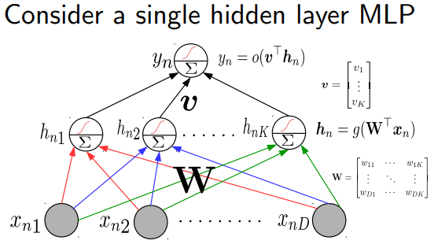
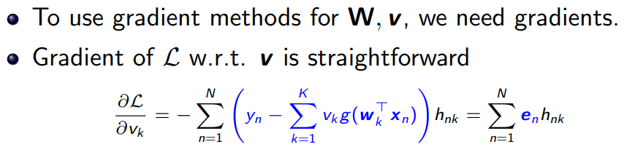
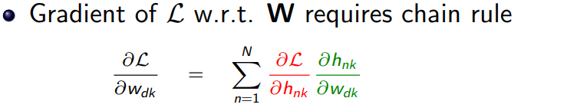
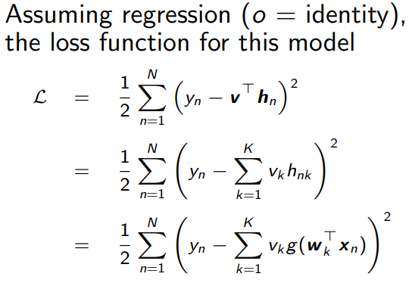


Backpropagation through an example
17

Slide 18
Backpropagation
18
Computes loss using current values of the parameters
Backprop iterates between a forward pass and a backward pass
Software frameworks such as Tensorflow and PyTorch support this already so you don’t need to implement it by hand (so no worries of computing derivatives etc)
Computes the gradient of the loss, starting with params in the last layer and going backwards
Backward Pass
Forward Pass
Using computational graphs

Slide 19
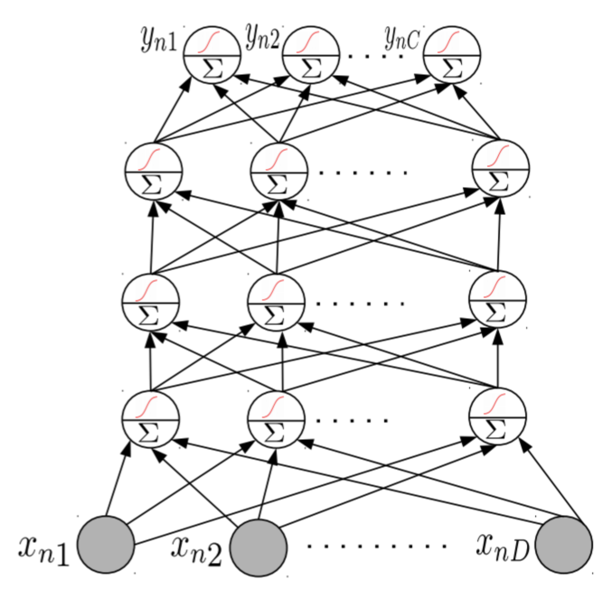
Neural Nets: Some Aspects
19
Much of the magic lies in the hidden layers
Hidden layers learn and detect good features
Need to consider a few aspects
Number of hidden layers, number of units in each hidden layer
Why bother about many hidden layers and not use a single very wide hidden layer (recall Hornik’s universal function approximator theorem)?
Complex networks (several, very wide hidden layers) or simpler networks (few, moderately wide hidden layers)?
Aren’t deep neural network prone to overfitting (since they contain a huge number of parameters)?
Choosing the right NN architecture is important and a research area in itself. Neural Architecture Search (NAS) is an automated technique to do this

Slide 20
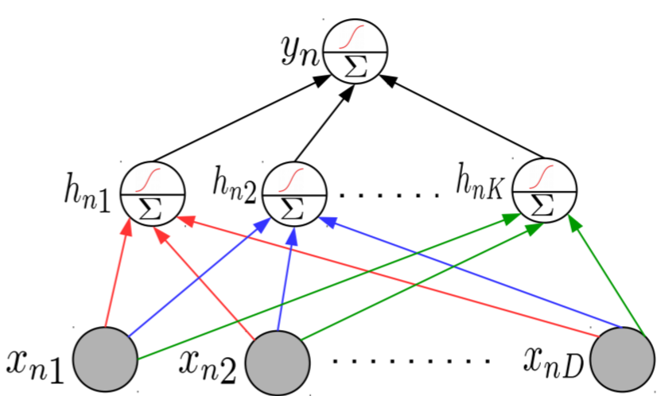
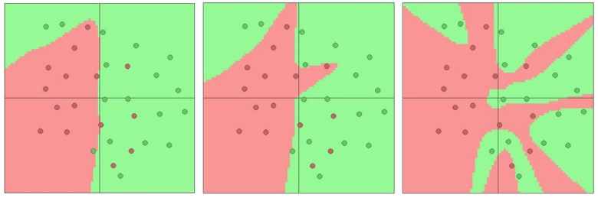
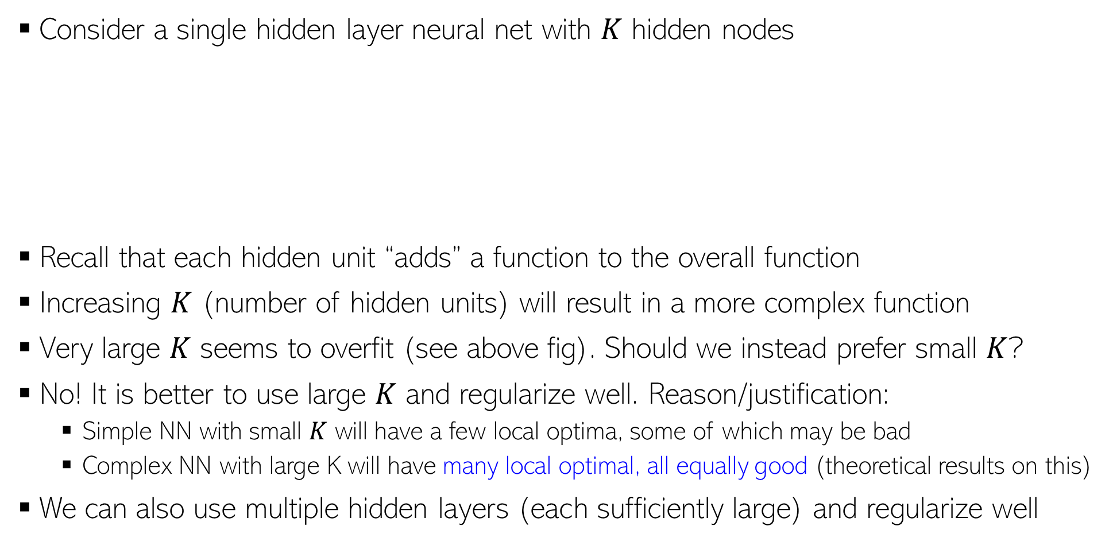
Representational Power of Neural Nets
20
Consider a single hidden layer neural net with $K$ hidden nodes
Recall that each hidden unit “adds” a function to the overall function
Increasing $K$ (number of hidden units) will result in a more complex function
Very large $K$ seems to overfit (see above fig). Should we instead prefer small $K$?
No! It is better to use large $K$ and regularize well. Reason/justification:
Simple NN with small $K$ will have a few local optima, some of which may be bad
Complex NN with large K will have many local optimal, all equally good (theoretical results on this)
We can also use multiple hidden layers (each sufficiently large) and regularize well
K = 3
K = 6
K = 20

Slide 21
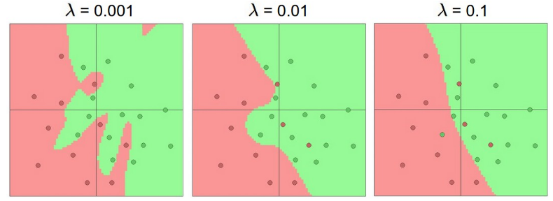
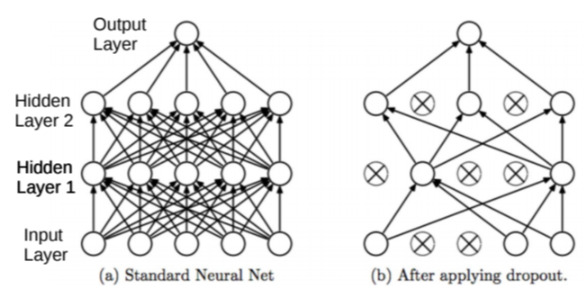
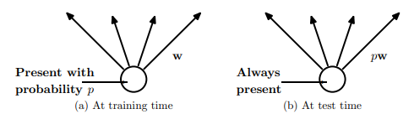

Preventing Overfitting in Neural Nets
Various other tricks, such as weight sharing across different hidden units of the same layer (used in convolutional neural nets or CNN)
21
Neural nets can overfit. Many ways to avoid overfitting, such as
Standard regularization on the weights, such as $ℓ_{2},ℓ_{1}$, etc ($ℓ_{2}$ reg. is also called weight decay)
Early stopping (traditionally used): Stop when validation error starts increasing
Dropout: Randomly remove units (with some probability $p∈ (0,1)$) during training
Single Hidden Layer NN with K = 20 hidden units and L2 regularization
Fig courtesy: Dropout: A Simple Way to Prevent Neural Networks from Overfitting (Srivastava et al, 2014)

Slide 22
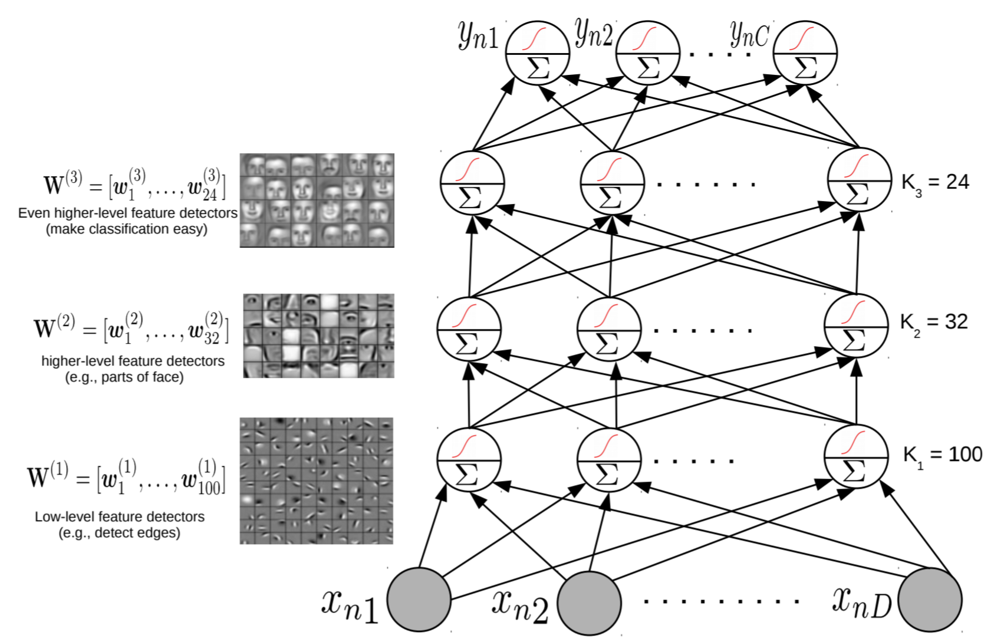
Wide or Deep?
22
While very wide single hidden layer can approx. any function, often we prefer many, less wide, hidden layers
Higher layers help learn more directly useful/interpretable features (also useful for compressing data using a small number of features)

Slide 23
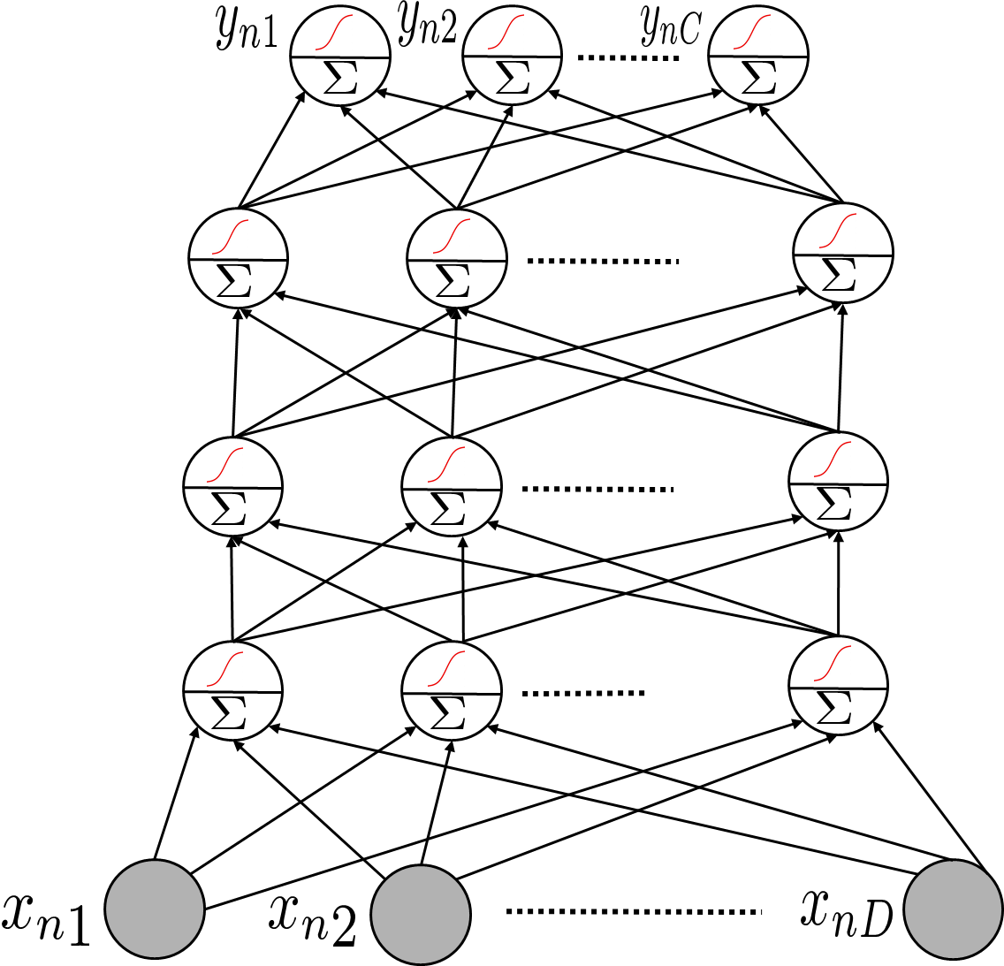
Using a Pre-trained Network
23
A deep NN already trained in some “generic” data can be useful for other tasks, e.g.,
Feature extraction: Use a pre-trained net, remove the output layer, and use the rest of the network as a feature extractor for a related dataset
Fine-tuning: Use a pre-trained net, use its weights as initialization to train a deep net for a new but related task (useful when we don’t have much training data for the new task)
This part of a pre-trained net can be used as a feature extractor on some new task
Many packages, like Tensorflow and PyTorch provide such pre-trained module ready to be used
Sometimes also known as “transfer learning” in the context of neural nets

Slide 24
Deep Neural Nets: Some Comments
24
Highly effective in learning good feature rep. from data in an “end-to-end” manner
The objective functions of these models are highly non-convex
But fast and robust non-convex opt algos exist for learning such deep networks
Training these models is computationally very expensive
But GPUs can help to speed up many of the computations
Also useful for unsupervised learning problems (will see some examples)
Autoencoders for dimensionality reduction
Deep generative models for generating data and (unsupervisedly) learning features – examples include generative adversarial networks (GAN) and variational auto-encoders (VAE)

Slide 25
Coming up next
25
Convolutional neural nets
Neural nets for sequential data
Neural networks for unsupervised learning and generation

